Slide 1


Microsoft Power BI Module 3 – Shaping and Combining Data

Slide 2
Agenda
Shaping Data
Transforming Data
Merging Data
Appending Data
Power Bl Data Model
Optimizing Models for Reports
Creating Hierarchies
Formatting Data
Combining Data
What are Hierarchies?

Slide 3
Shaping Data

Slide 4
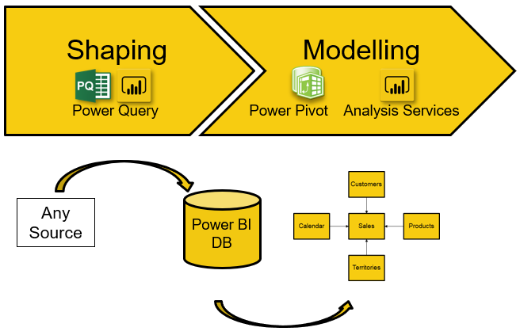
Shaping Data
Shaping data is the process of transforming data, in which Power Query Editor loads and presents the data in the best way.
Here, we only deal with View in Power Bl Desktop, so the original data remains unchanged.
All the steps that we perform will be captured by Applied Steps in the Query Settings pane.

Slide 5
Shaping Techniques
Sorting
Adding Columns & Indexes
Date & Time Functions
Removing Columns & Rows
Removing Columns
Data Types

Slide 6


Shaping Data
Removing Rows & columns
If we have a large dataset, we need to remove redundant and unnecessary data to make it as small as possible, which improves the performance of data handling in Power Bl.
Renaming Columns
Columns should have names that make them easy to work with, and each column should give an adequate description of the data that it contains.

Slide 7
Shaping Data
Data Types
Power Query Editor predicts the data type of each column when loaded with the data, but it is always advisable to check the given column data types and then format if necessary.
Date & Time Functions
We should also format date-time columns with the correct data type and use these columns to extract the year, quarter, month, week, day, time, hour, etc.

Slide 8

Shaping Data
Removing Rows & columns
If we have a large dataset, we need to remove redundant and unnecessary data to make it as small as possible, which improves the performance of data handling in Power Bl.
Renaming Columns
Columns should have names that make them easy to work with, and each column should give an adequate description of the data that it contains.

Slide 9
Demo: Shaping Data

Slide 10
Formatting Data

Slide 11
Formatting Data
Formatting data helps in categorizing and identifying the data and making it much easier to work with
Data Formatting
Text Formatting
Number Formatting
General Formatting
In Power Query Editor, we apply formatting functions to our text and number columns to create consistency and ensuring that the data is well presented

Slide 12
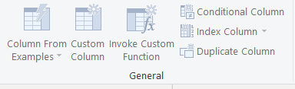
Formatting Data
General Column in Power Query Editor helps us create a
custom column or a duplicate column. It also lets us add an
index column to the table.
General formatting includes:
Data Formatting
Text Formatting
Number Formatting
General Formatting

Slide 13
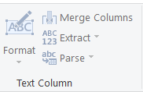
Formatting Data
From Text provides options for formatting string values,
merging columns, extracting values, and parsing to other
formats
Text formatting includes:
Data Formatting
Text Formatting
Number Formatting
General Formatting

Slide 14

Formatting Data
From Number offers a wide range of formatting functions for
number columns, such as
Statistics, Standard, Scientific, Trigonometry, Rounding,
and Information.
Number formatting includes:
Data Formatting
Text Formatting
Number Formatting
General Formatting

Slide 15
Transforming Data

Slide 16

Transforming Data
While Power Bl is flexible with a variety of data sources that we can import data from, visualizations work best with the data that is in a columnar format
For example, data imported from Excel may be easy for the human eye to visualize but might not be structurally appropriate for Power Bl to translate the values into visuals
Power Query Editor offers plenty of functions to transform data into a structure that Power Bl can use effectively to buildreports

Slide 17
Transforming Data
Group By
Pivot Column &
Unpivot Columns
Move
Transforming
Data
Replace Values & Replace Errors
Rename
Detect Data Type
Use First Row as Headers
Transpose
Reverse Rows
Count Rows
Data Type

Slide 18
Transforming Data
Group By
We can aggregate one or more columns in a table. For that, we have to click on Group By on the Table group and select the columns we want to include.
Use First Row as Headers
If we import columns with numeric values that include a header, Power Bl can detect that the first row is a string and that it is the header. This is not so obvious when all of the columns contain string values. We use this function to make the values of the first row as the header

Slide 19
Transforming Data
Reverse Rows
This function reverses the order of the rows in the table such that the bottom rows come at the top and the top rows go at the bottom
Transpose
With Transpose, we can treat rows as columns and columns as rows. This is useful if we import a table from a spreadsheet in a matrix format but do not translate it into a format that Power Bl can use easily

Slide 20
Transforming Data
Count Rows
We use this function to return the number of rows in the current table. The rows are replaced with the count of the rows
Data Type
The Data Type function is useful for formatting the columns where Power BI has incorrectly guessed the data type

Slide 21
Transforming Data
Rename
To rename a column, we select the column in the table and click on Rename from the Any Column group, or we can right-click on the column and then click on Rename
Detect Data Type
We can select one or more columns and use the built- in data type detection function. Power Bl uses this function to automatically correct the wrongly guessed data types.

Slide 22
Transforming Data
Replace Values & Replace Errors
With these two functions, we can very quickly replace a value or an error in a column with another value. Both functions can work on one or more columns
Fill
We can use the Fill function to fill in the null values with values from adjacent cells either in an upward or in a downward direction. This function works only at the column level.

Slide 23
Transforming Data
Pivot Column & Unpivot Columns
The Pivot Column function takes in values from a selected column and uses them to create a new column. The Unpivot Columns function can also help with this but by converting the selected columns into attribute—value pairs
Move
The Move function moves one or more columns to another location in the table. We can move the columns to the left, to the right, to the beginning, or to the end.

Slide 24
Demo: Transforming Data with Power Query Editor

Slide 25
Combining Data

Slide 26
Combining Data
By using Power Bl, we can gather data from different sources and different types into a single dataset to
build reports
Combining Data
Merging Data
Appending Data

Slide 27
Combining Data – Merging Data

Slide 28
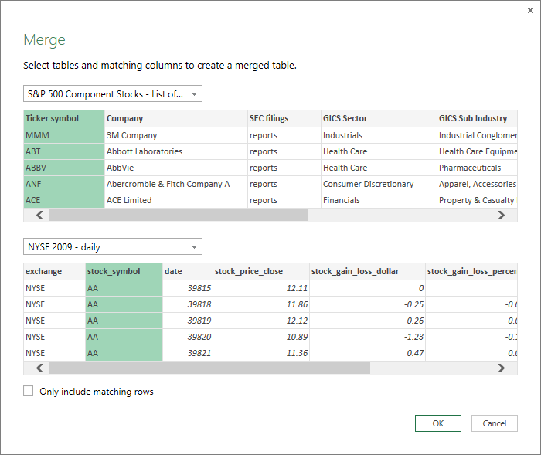
Combining Data – Merging Data
To merge columns of two tables, the two tables must have a joining column, where the values match in order so that they can be combined

Slide 29
Combining Data – Merging Data
These are the Joins used in Merging data
Left Outer
Full Outer
Left Anti
Right Outer
Inner
Right Anti
All rows from the first table and the matching rows from the second table
All rows from both tables
Rows only from the first table
All rows from the second table and the matching rows from the first table
Matching rows from both tables
Rows only from the second table

Slide 30
Combining Data - Appending Data

Slide 31
Combining Data -Appending Data
When we append rows, we take rows from one or more tables and add them to the first table
In most situations, the columns and the data types will match. However, we can also append rows between two tables that have all different columns, but the result will be unclean. There will be no values when the number of columns of these tables does not match.
If we are appending rows from multiple sources and if the table contains index values that overlap when the data is combined, we combine the data and then create a new index column on the table into which the rows are appended.

Slide 32
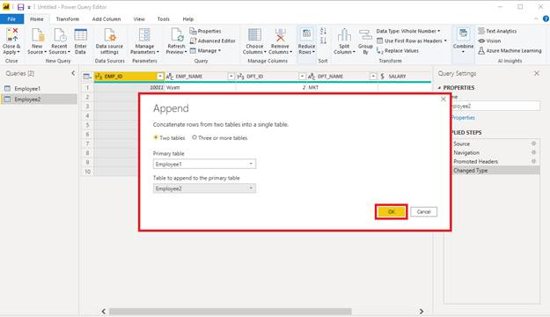
Combining Data -Appending Data

Slide 33
Demo: Combining Data in Power Query Editor

Slide 34
Power Bl Data Model

Slide 35

Power Bl Data Model
A data model is typically associated with a relational database, such as Microsoft SQL Server. In Power Bl Desktop, we connect to multiple data sources and bring data together in the data model by creating relationships between them.
In a data model, we can create calculated tables and columns, relationships, hierarchies, etc. and change data types, defaults, and properties.
If we do all these right in our model, then the creation of reports will be a much smoother process, and it will produce moreaccurate results.

Slide 36
Power Bl Data Model
Things to keep in mind while developing a model in Power Bl:
Data types
A wrong data type might cause incorrect results in our visuals. When importing numbers, we have to be accurate and determine whether we need precise rounding
Cross-filtering
When we turn on bi-directional cross- filtering in our relationships, it enables the tables in our star schema to operate as if held in a single table, and we can join and aggregate values between the dimension tables
Fact and Dimension Tables
The data is stored in fact tables, and the descriptive information about the data is stored in dimension tables
Reduced Size of the Dataset
To reduce the volume of the data, we can join the tables, apply filters, or remove the data that will not be used in visualization

Slide 37
Optimizing Models for Reports

Slide 38
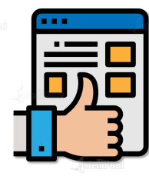
Optimizing Models for Reports
Data is frequently in a raw format when we import it into Power BI, especially if we have taken it directly from a database
When we combine data from different data sources into the Power Bl model, there is a high chance that the data will have different formats and data types
Optimizing the data makes it more consistent and helps us work with it more efficiently, focusing on the information we need

Slide 39
Optimizing Models for Reports
Three techniques to optimize our data in the model:
Hide Fields
It is good to hide fields that we are not going to use in our visuals. Hiding a field removes the field name from the Fields pane, but neither the column nor the underlying data will be deleted
Sort Data
Power Bl automatically sorts data, but when we want the data to be ordered in a particular way, this can also be done. It makes data analysis much easier for users
Format Data
Changing data types and formatting the data are good ways of optimizing our data, and it helps in presenting the same with clarity in reports and dashboards

Slide 40
What are Hierarchies?

Slide 41

What are Hierarchies?
A hierarchy is a set of related fields grouped together to drill down from one level to the next.
Each level of the hierarchy is contained within the next level, and it cannot exist independently.
Power Bl automatically creates a hierarchy on date-time fields. However, we can also create our own hierarchies within the model to suit our requirements for analysis.

Slide 42
What are Hierarchies?
Examples of hierarchies that we can create in Power Bl to drill down from top to bottom:
Country
State
City
Street
Year
Quarter
Month
Day

Slide 43
Creating Hierarchies

Slide 44
Creating Hierarchies
Power Bl Desktop > Fields
Select a column and create a hierarchy
Right-click to specify the new name
Click on the ellipsis of another column to add to the hierarchy
Repeat to add multiple columns; we can also move, delete, & rename

Slide 45
Demo: Creating Hierarchies

